Slide 1

Azerbaijan Oil & Gas Outlook
Ilgar Mehti, Managing Partner, EKVITA - Baku

Slide 2

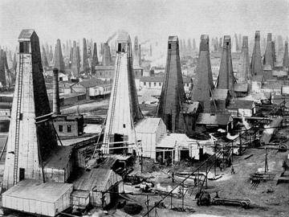
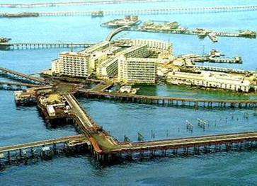
History
6th Century BC – Persian army of Kir II used Baku oil in weapons of fire to invade castles and cities
1273 – Marco Polo visits Baku and records seeing oil collected from seeps for use in medicine and lighting
1723 – Peter I issues special decrees about the order of oil extraction in Baku
1844 – first oil well in the world was drilled in Baku in Bibi Heybat oil field
1873 – the Nobel Brothers Oil Extracting Partnership was set up
1900 – Azerbaijan produced more than 50% of world’s oil
1907 – first largest oil pipeline in the world was completed from Baku to Batumi = 883 km x 200mm
80% of oil produced during WWII in USSR was made in Baku

Slide 3
Oil Reserves

Slide 4
Transit Routes
Novorossiysk
Russia
Kazakhstan
Black Sea
Georgia
Tbilisi
Caspian Sea
Supsa
Baku
Turkmenistan
Azerbaijan
Kapaz
Turkey
Erzurum
Alov
Ceyhan
Iran
Med.
Sea
Syria
Iraq

Slide 5
Adding Gas to Oil
Shah Deniz Gas Field – the largest discovery since 1978
Exporting gas to EU, Georgia, Russia and Iran
Significant future export potential – circa 25 bln m3
Multiple export routes being lobbied by EU

Slide 6
GDP Growth
Year | % GDP Growth
1999 | 11.4
2000 | 6.2
2001 | 6.5
2002 | 8.1
2003 | 10.5
2004 | 10.2
2005 | 26.4
2006 | 34.5
2007 | 25
2008 | 10.8
2009 | 9.3
2010 | 4.3

Slide 7
Legal Framework
Subsoil Law
Energy Law
Energy Resources Law
More than 20 PSAs, but:-
No unified Petroleum Law or PSA law

